Slide 1
3-Level NPC Inverters
Thesis: DC-LINK CAPACITOR SIZING OF THREE-LEVEL NEUTRAL POINT
CLAMPED VOLTAGE SOURCE INVERTERS FOR VARIABLE SPEED DRIVES

Slide 2
Advantages & Disadvantages
Advantages against 2-Level Inverter:
- Efficiency
- 1/2Vdc voltage stress
Disadvantages against 2-Level Inverter :
- Complexity
- Unequal Power Loss

Slide 3
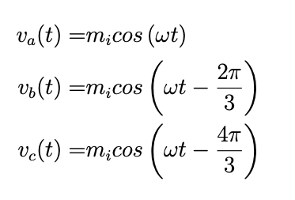
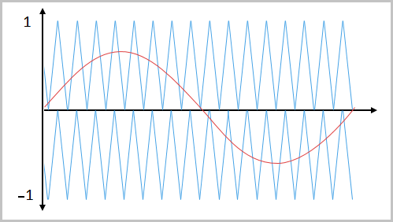
Sinusoidal PWM
Phase voltages (reference signals);
Two triangular carrier signal
[0,Vdc/2] & [-Vdc/2,0]
Peak amplitude=Vdc/2

Slide 4
Sinusoidal PWM
State | Q1 | Q2 | Q3 | Q4
Carrier1<reference Carrier2<reference | ON | ON | OFF | OFF
Carrier1>reference Carrier2<reference | OFF | ON | ON | OFF
Carrier1<reference Carrier2>reference | OFF | ON | ON | OFF
Carrier1>reference Carrier2>reference | OFF | OFF | ON | ON

Slide 5
Sinusoidal PWM
This method does not control the neutral point.
Large capacitors needed.
Worse case for low frequency NPP ripple can be expected at
high modulation index
high load current
low fundamental frequency
low power factor for SPWM modulation.

Slide 6
SVPWM
Applicable but more complex.
Switching States:
State | Q1 | Q2 | Q3 | Q4
P (S1) | ON | ON | OFF | OFF
O (S2) | OFF | ON | ON | OFF
N (S3) | OFF | OFF | ON | ON

Slide 7
SVPWM
State S1(P): Output voltage: Vdc/2. (voltage difference between node and neutral point) Top two switches are ON.
State S2(O): Middle switches are ON. Output voltage is 0.
State S3(N): Bottom 2 switches are ON. Output voltage: -Vdc/2

Slide 8
SVPWM
Totally 27 switching states
All possible switching states represented at the left.
Vectors have different lengths.
Largest vectors are obtained when all phases have non-O states.
Middle vectors: one phase at O-state.
Small vectors: two phases at O-state. Two alternative vectors for small vectors.

Slide 9
SVPWM
Va | Vb | Vc | Main Sector | Center vector
>0 | <0 | <0 | 1 | POO/ONN
>0 | >0 | <0 | 2 | OON/PPO
<0 | >0 | <0 | 3 | OPO/NON
<0 | >0 | >0 | 4 | OPP/NOO
<0 | <0 | >0 | 5 | OOP/NNO
>0 | <0 | >0 | 6 | POP/ONO
required output vector is obtained by using four vectors.
Six major regions. Each major regions have six sub-regions.

Slide 10
SVPWM
Each subregion has at least four vectors.
Space vector hexagon of two-level inverter and subregions of major region are similar
Subregions of Major Region 1

Slide 11
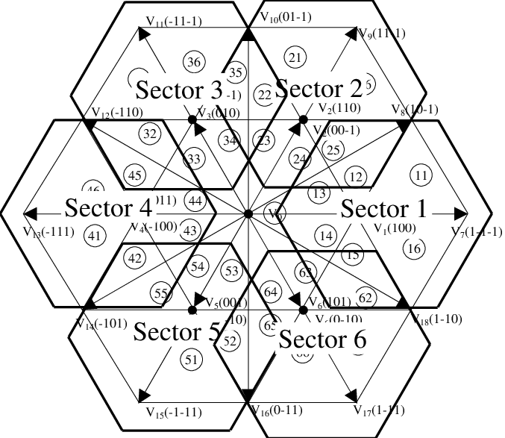
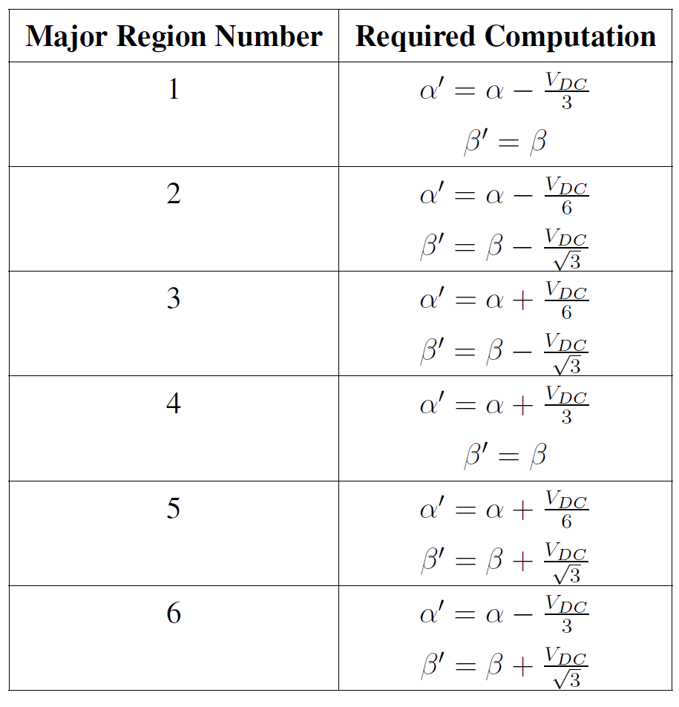
SVPWM
Move vector at the center of hexagon.

Slide 12
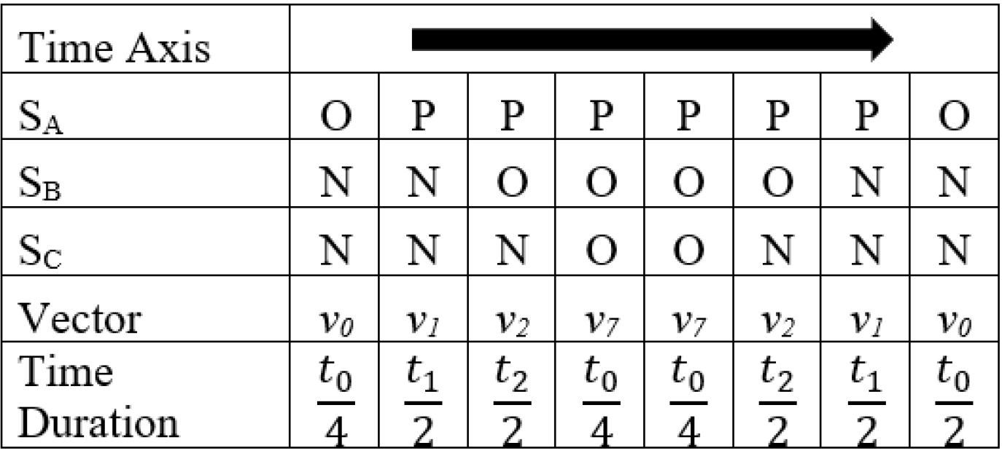
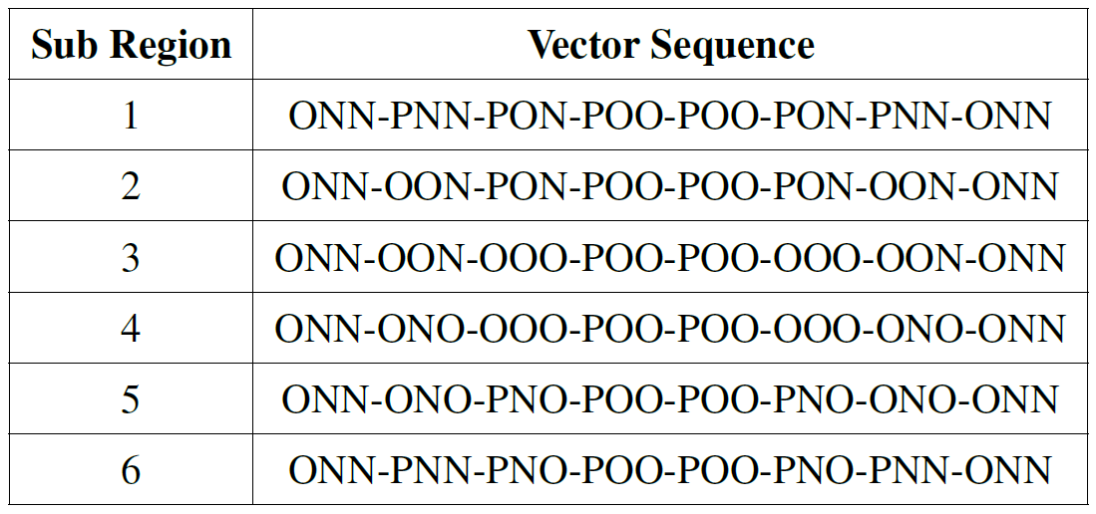
SVPWM
Vector sequences:
Time sequence
Vector sequence

Slide 13
NP Unbalance Capacitor Voltage
Phase current charges one capacitor while discharging the other. This causes the ripple.
2 types of NPP ripple:
Fundamental freq. Low frequency NPP ripple has largest component at three times the fundamental frequency. can be controlled with control loops in the PWM method.
Switching freq. this ripple type can not be controlled with closed loops added to PWM method.
Top charging, bottom discharging
Bottom charging, top discharging

Slide 14


NP Unbalance Capacitor Voltage
Voltage on C1: $\frac{V_{dc}}{2}+\frac{V_{DC}}{2}\frac{∆V}{100}$
Voltage on C2: $\frac{V_{dc}}{2}+\frac{V_{DC}}{2}\frac{100−∆V}{100}$
Voltage stress larger than switch’s voltage limit can be damaged to semiconductor.

Slide 15
NPP Control Methods
Nearest Triangular Vector (NTV) Method
Vector selection depends on ref. voltage and neutral point potential.
Finding borders of region is same but sequence is different.

Slide 16
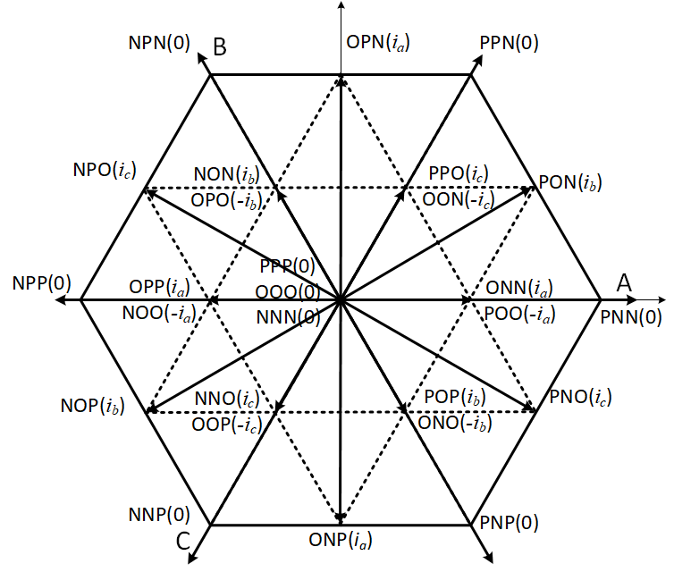

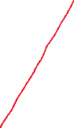



NPP Control Methods
Nearest Triangular Vector (NTV) Method
Region grouped according to, geometric property and effect on NP voltage.
Group-a (red) : [PNN,NPN,NNP], no effect on neutral point voltage balance. No current at NP.
Group-b (blue): [PPN, NPP, PNP], negative sequence of abc.
Group-c (green): [OPN, NPO, PON, NOP, PNO, ONP] these vectors have non-zero NP current.
Group-0: [PPP, OOO, NNN], zero vectors.

Slide 17
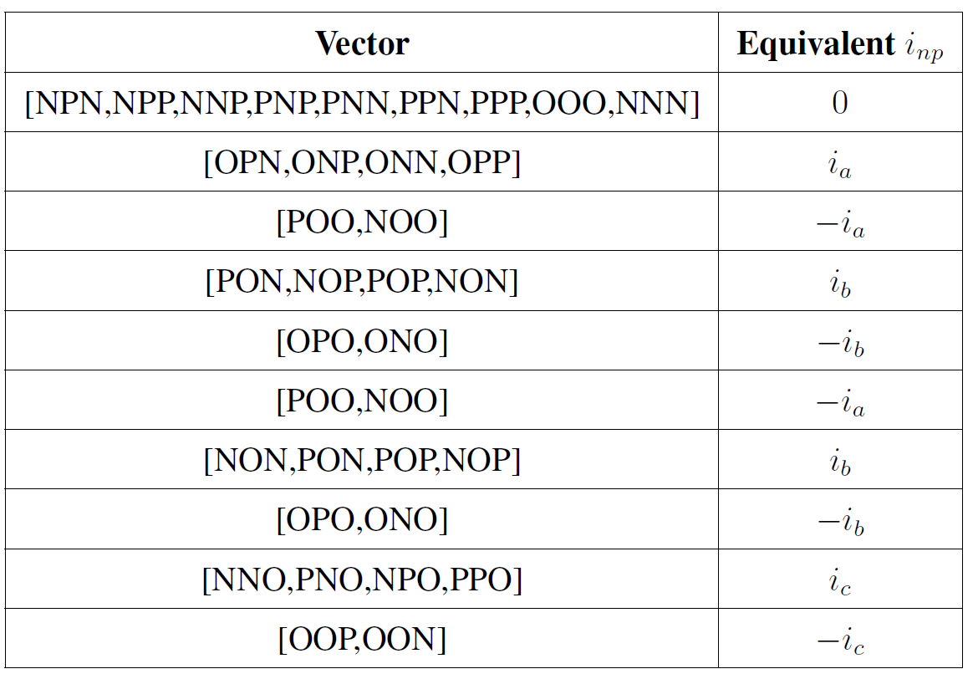
NPP Control Methods
Nearest Triangular Vector (NTV) Method

Slide 18
NPP Control Methods
Symmetric SVPWM Method

Slide 19
NPP Control Methods
Carrier Based Method

